Slide 1
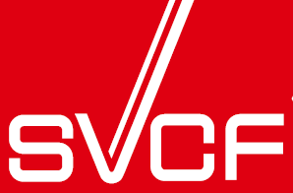
Facts and Tasks
at Fukushima Daiichi
August 2012
Skilled Veterans Corps for Fukushima
Notes:
Thank you Chairperson and all of you who have come here to hear me speak.
Today I’d like to inform you about what is happening at Fukushima Daiichi and the solution we are proposing for containment and cleanup.
There is overload of information and most of people are confused and uncertain about what is cover-up or rumor. I strongly suggest you not limiting your focus to any specific problem, but rather see the big picture, and view it as one big problem made up of many interrelated and interconnected parts, facts, and problem. We will start by looking at some pictures and figures revealing some of the basic facts of what is happening at Fukushima Daiichi.

Slide 2
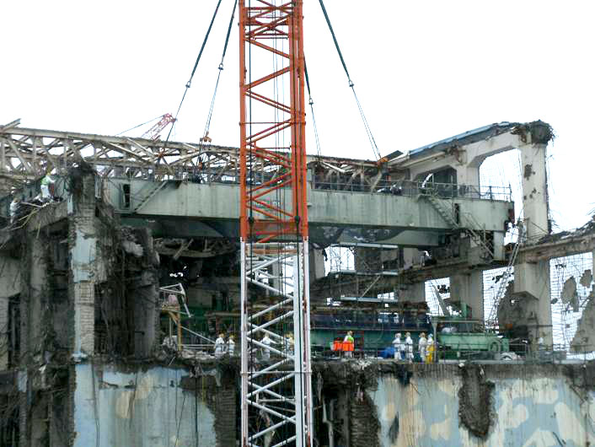
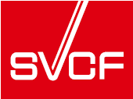
Facts at Fukushima Daiichi
UNIT 4
Quote TEPCO
Building of Unit 4 at Fukushima Daiichi
1
Notes:
This is the building housing of Unit 4. Spent fuel pool of this unit, which contains 1535 spent fuel rods, has been a big source concern recently. That concern is due to the ever-present danger of another earthquake occurring and causing the water to drain from the pool, which would unleash a nuclear fire. Consequently, efforts have been made to reinforce this building.
Unit 4 was not under operation when the earthquake and tsunami struck. Because of that, the building is fortunately less contaminated by radiation as compared to the much more dangerous levels found in units 1, 2, and 3. I entered this building in July of last year as the reinforcement work was being carried out.
You can see some workers on the top floor which hopefully means that the contamination level is not very serious.

Slide 3
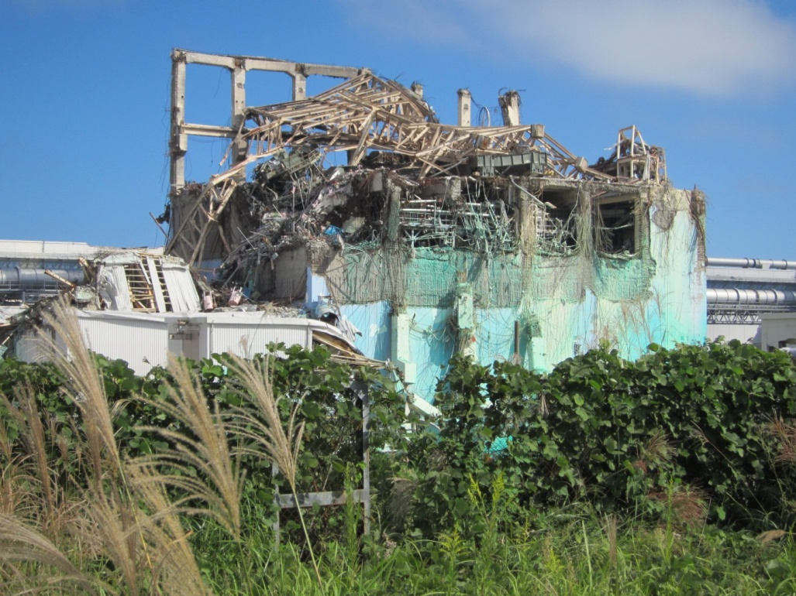
Facts at Fukushima Daiichi
UNIT 3
Quote TEPCO
Building of Unit 3 at Fukushima Daiichi
2
Notes:
This is the building housing of Unit 3, taken in autumn 2011. The structure continues to crumble day by day. This building also hold spent fuel although the amount stored is much less than that in Unit 4. Presently top part of the building is being removed. However, inside of the building is contaminated in the level of 10 to 1600 mSv/hr. If you see the contamination level in Unit 1 is 25 to 13,000 mSv/hr, and in Unit 2 is 5 to 73,000 mSv/hr. Exposure of 7 Sv is the level that you will die immediately. Because of this, there is no action to reinforce these building housings is taken place.
Therefore, I evaluate that the risk of the damage of spent fuel pools in Units 1, 2 and 3 are being much higher than that for Unit 4. Even the amount of spent fuel in those units is much less, it is still enough to cause an extremely serious crisis.
TEPCO plans to remove spent fuel from Unit 4 in before removing from the other Units. I believe that the reinforcement of those three units are more essential than removal of spent fuel from Unit 4.

Slide 4
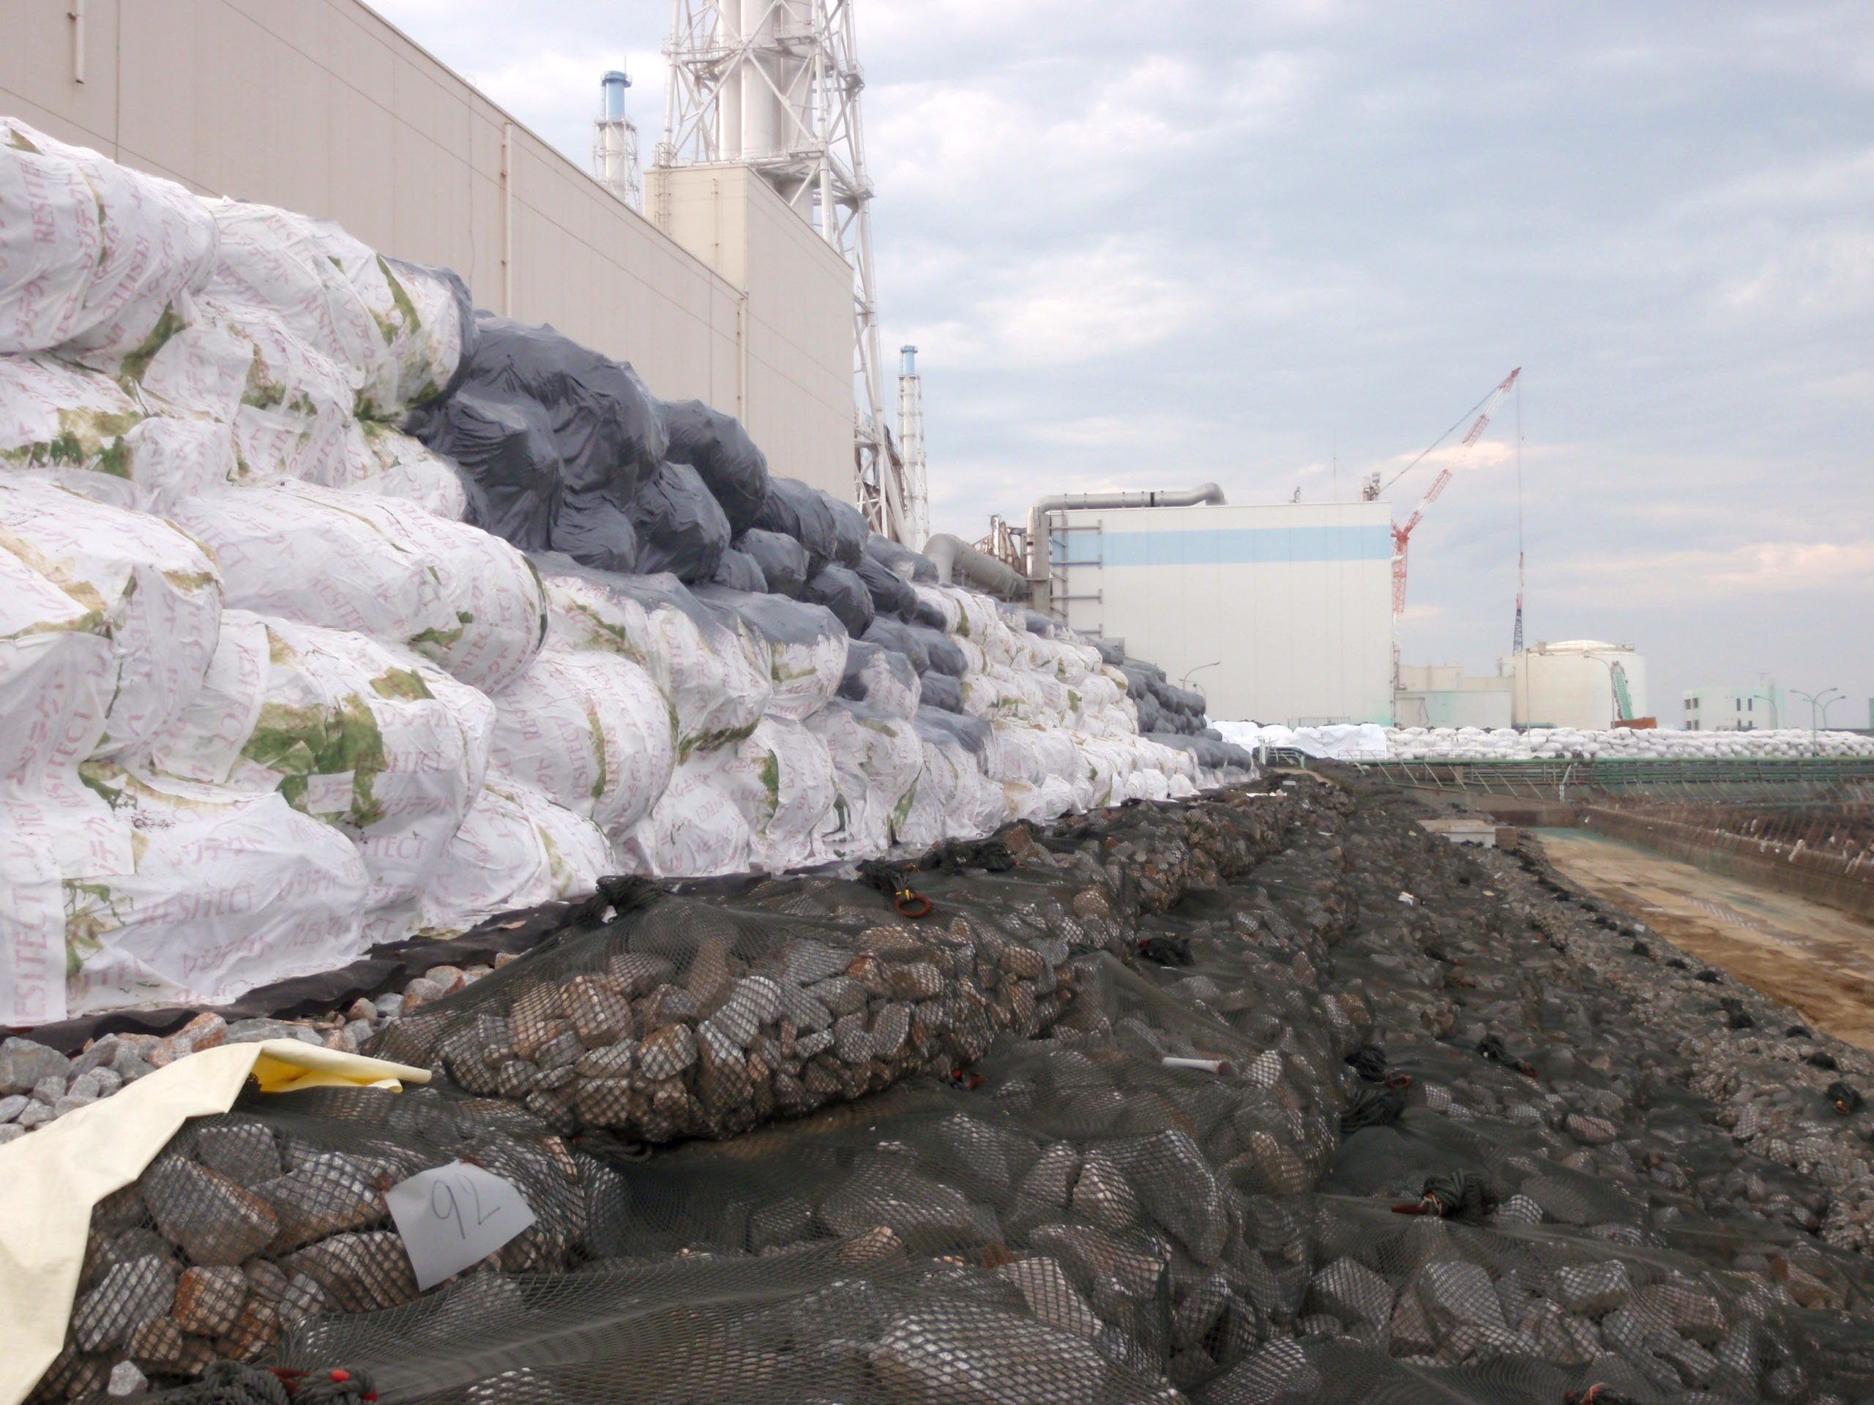
Facts at Fukushima Daiichi
Quote TEPCO
Temporary Seawall at Fukushima Daiichi
3
Notes:
What you see here is temporary newly-constructed seawall to prevent damage by another Tsunami. This wall is 50 feet high above the sea level, while the last tsunami had 40 feet height.
TEPCO claims a computer simulation has calculated that this seawall is safe enough, and therefore, there is no plan to install conventional permanent seawall in TEPCO’s road map for mid-range and long term planning which takes for 40 years.
I’d like to call your attention to this issue. We do not believe it credible that such makeshift work will adequately protect Fukushima Daiichi in the event of another Tsunami, particularly if it is meant to serve as a safeguard for the project is planned to take 40 years.

Slide 5
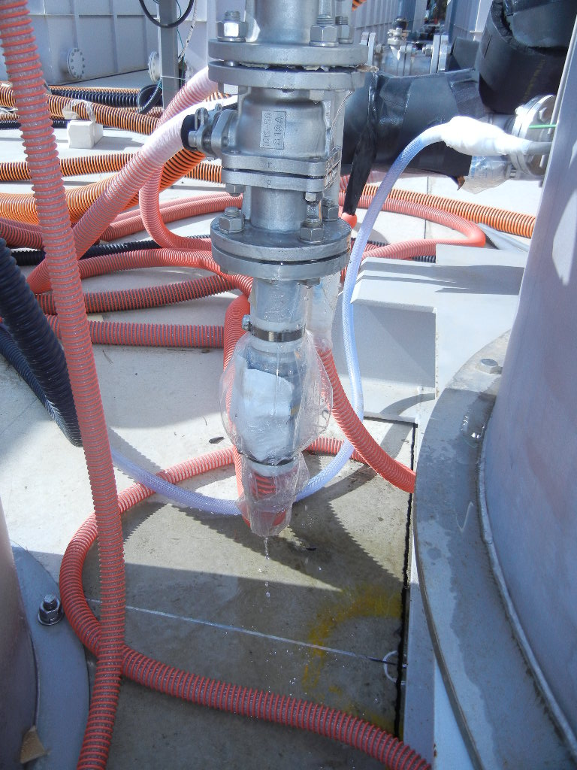
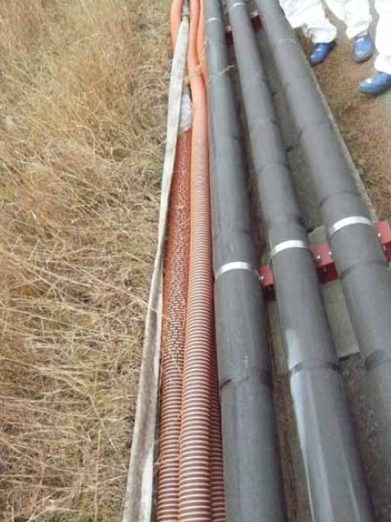
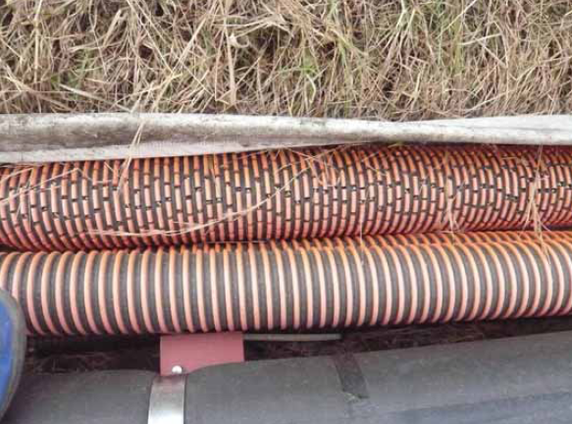
Facts at Fukushima Daiichi
Quote TEPCO
Hoses for Contaminated Cooling Water
4
Notes:
Here, you see hose lines conducting cooling water to nuclear vessels. It should be noted that such a flexible hoses like these are prohibited for use in any plant meant for long term operation. They may be employed only emergency situations, such as fire fighting since such a plastic hoses are weak to weathering.

Slide 6
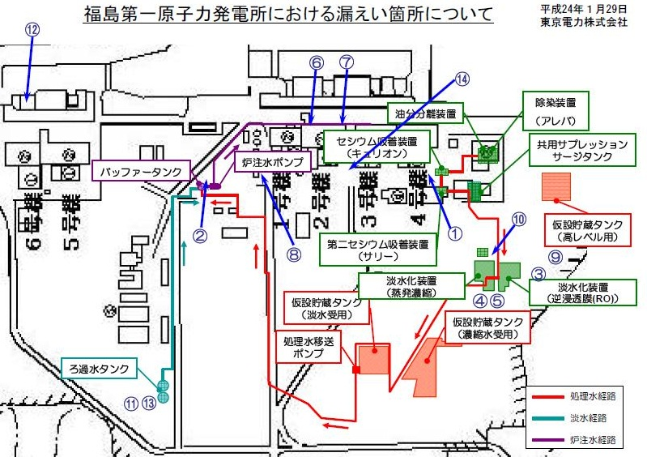
Facts at Fukushima Daiichi
Quote TEPCO
Route of Cooling Water Hoses and Leakages
5
Notes:
The routes of the cooling water are shown in this figure. The total length of hose line is more than 2.5 miles.
There is no plan to replace those hose lines with steel pipes. This is because there are so many places highly contaminated by radiation that it’s impossible to work which takes a long time to complete, such as installing bases, supports for steel pipes, etc.
Referring to those progresses and plans, we would com t conclusion that TEPCO has only very short term view saving expenses as the site of Fukushima Daiichi. It seems to be quite reasonable as a profit oriented private company.

Slide 7
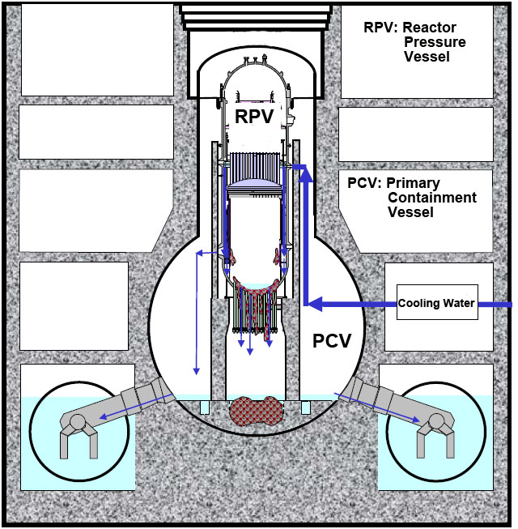
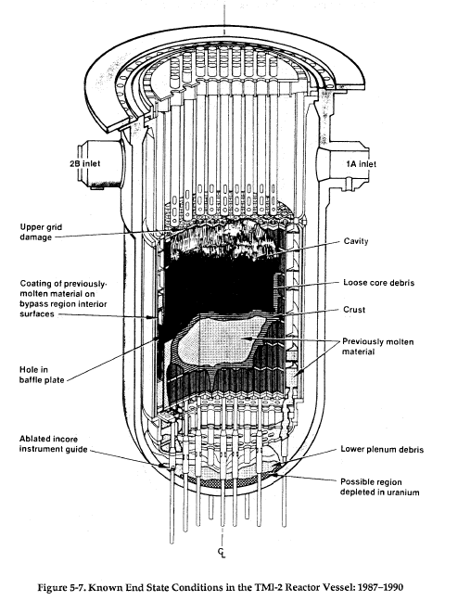
Facts at Fukushima Daiichi
Fuel Debris
Quote EPRI
Quote TEPCO
Present Status of Fuel Debris (Estimated)
6
Notes:
Fuel debris in the Reactor Pressure Vessel in Unit 1 is simulated in this figure. If you compare with what occurred at Three Mile Island shown at right side, the severity of damage at Fukushima Daiichi is very clear. At Three Mile Island, RPV was not damaged and fuel remained within the RPV.
According to TEPCO’s estimate, molten fuel has eroded the concrete at PCV bottom to the depth of ２６ inches. If you consider the range of error for the estimation calculation, we must not dismiss the possibility that the bottom plate of PCV is damaged.
According to recent survey results, water level in the PCV is approximately 20 inches, which indicates water leaks at the part of connecting pipes between PCV and Torus, but it does not mean the bottom shell of PCV is sound, because it is sealed by cement concrete at the bottom.

Slide 8
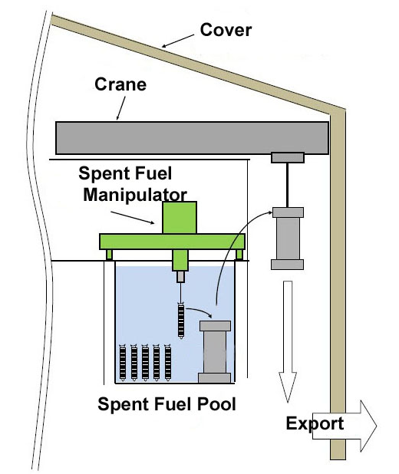
Tasks at Fukushima Daiichi
Spent Fuel Removal
Quote TEPCO
Spent Fuel Removal
7
Notes:
The first step of the cleanup is removal of spent fuel, since the fuel debris in the vessels shall be firstly stored in this pool. Spent fuel shall be handled in the water which acts as radiation sealing material. Spent fuel is transferred into the cask in the water pool, and then lifted up by the crane, and loaded onto a huge truck, which then transports the cask to the storage area on the ground.
In the case of Three Mile Island the spent fuel pool was empty since the accident took place after three months of the first commisioning.
The interior of the spent fuel pool is in disarray, because a huge amount of debris caused by the explosion must have damaged some of spent fuel blocks. Therefore, operation of the manipulator must be done manually, from just above the pool, within contaminated building.
In Unit 4’s case, contamination of building is not very high, but the buildings housing of Units 1, 2, and 3 are seriously contaminated, which cause high level radiation exposure. This work is planned to start in 2015, three years from now.

Slide 9
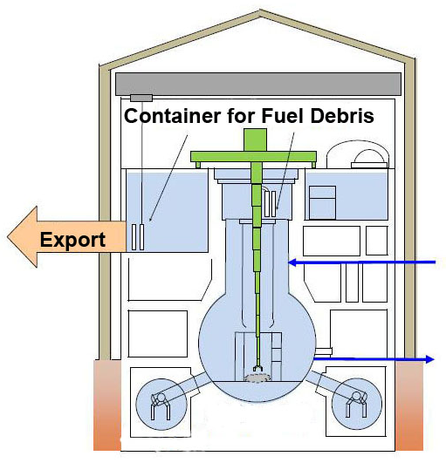
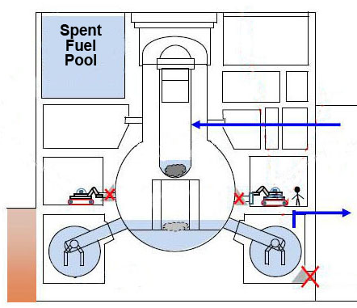
Tasks at Fukushima Daiichi
Repair of PCV (lower)
Fuel Debris Removal
Quote TEPCO
Steps for Fuel Debris Removal
8
９
Notes:
After free space is prepared in the spent fuel pool, removal of fuel debris can begin. However, this work requires filling the PCV with water, which means the PCV must be repaired to be water tight.
Repair of the PCV has to be carried out in highly radioactive atmosphere, even after decontamination.
Fuel debris is located approximately 120 feet under the manipulator.

Slide 10
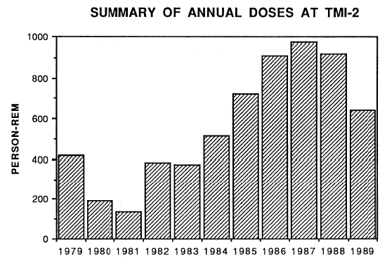
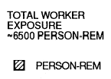
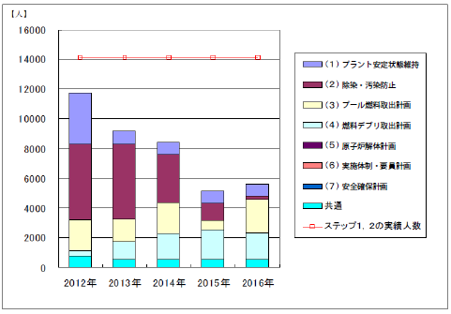
TMI-2 Cleanup Experience
1984-1989
Fuel Removal
2019
2020
2021
Quote TEPCO
Quote EPRI
Annual Doses at TMI-2 and TEPCO’s Estimation of Man Power Requirement
9
１１
Notes:
Black and white graph indicates annual radiation doses for workers at Three Mile Island. You can see that the doses are quite high during fuel removal.
The small graph was published by TEPCO, which indicates projected number of workers required. TEPCO emphasized that shortage of workers is not expected. However TEPCO has estimated only for five years, and didn’t include the time required for debris removal which is expected to start 10 years later from now in 2022.
As you saw earlier, Reactor Pressure Vessel at Three Mile Island wasn’t damaged. In addition to that. It means fuel removal at Fukushima Daiichi must be far more complicated than that at Three Mile Island.
We have to seriously consider the possibility that dangerous level of radiation exposure may still be present in Fukushima Daiichi ten years later.

Slide 11
Appeal of SVCF
SVCF requests:
Skilled Veterans
be allowed to work
at Fukushima Daiichi
to reduce doses for
Younger Workers
Statement
10
Notes:
Now we are ready to talk about “SVCF”, Skilled Veterans Corps for Fukushima. We are requesting that skilled veterans be allowed to work at Fukushima Daiichi to reduce radiation doses for younger workers where “Veterans” means not only from the military but also retired technicians and engineers.
There are three reasons why elder persons have advantages to the radiation exposure than younger persons.
The first reason is that the DNA is damaged by radiation takes place at the time of cell split. The frequency of cell sprits is much less for elders than youngers.
Secondly, even if DNA would be damaged, elders would die by other reasons earlier than cancers caused by DNA damage.
Thirdly, the elders may no more chance to make child, that ensure to not leave risk by radiation exposure to the next generation.

Slide 12
Appeal of SVCF
March 11, 2011 Earthquake and Tsunami
April 10, 2011 First Appeal was delivered
May 4, 2011 First negotiation with TEPCO
May 24, 2011 Meeting with Mr. Hosono
and TEPCO
July 12, 2011 SVCF Inspection Team to
Fukushima Daiichi
August 3, 2011 Proposal to Government and
to TEPCO
Progress
11
Notes:
I myself started recruiting members in April, 2011. In May, 2011 we had a meeting with TEPCO’s board members and Mr. Hosono, presently Minister for Accident of Fukushima Daiichi. As a result of this meeting, in July 2011, our representatives went onsite and inspected Fukushima Daiichi. It was the first private team outside of TEPCO to enter the site. Furthermore we have submitted proposal to the government and TEPCO based on the inspection results. We thought we’d accepted and expected that SVCF would be able to work soon afterwards. However, that didn’t happen.
After those events, we have continued to negotiate with the government and TEPCO including its subsidiary companies.
However, the Japanese government says that “You are welcome if TEPCO will accept you”, and meanwhile TEPCO says “Presently TEPCO has no room to accept SVCF members”. What is going on?
Meanwhile, our numbers have swelled almost 700 members, 1700 supporters, and 500 donors.

Slide 13
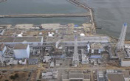
Barrier for Fukushima Daiichi
TEPCO
Fukushima Daiichi
Dose Control for
Workers within
Fukushima Daiichi
400 Contractors
Workers
Prime
Contractors
Workers
Sub-
Contractors
A
B
C
D
E
F
Dose Control
by Employer not to Exceed Limit
Value
Workers
2nd Sub-
Contractors
a
b
c
d
e
Workers
Dose Control by
Each Worker
3rd Sub-
Contractors
Workers
Limited Responcibility by TEPCO for Dose Control
12
Notes:
During the negotiation we have found following facts:
Over 3000 people are working at Fukushima Daiichi every day. The hiring pattern and contract structure being used for sub-contractor must be highly unusual from you view point. Almost 400 different companies have been brought in, while TEPCO’s employees are only some tens but not more. That means on average less than 10 workers per sub-contractor. Further, the contacts are multi layered in seven or eight layers deep. This contract structure must be quite unique in Japanese heavy industries, and very beneficial for TEPCO, since they can try to avoid accountability removing several steps of detailed onsite planning and management.
Another effect of this structure is TEPCO has no capability to accept our proposal. They are not able to allocate SVCF’s member to any working place at the site.
This contract structure has serious disadvantage for workers safety. Since TEPCO receives workers radiation dose information only as the results given to them second-hand by the sub-contractors, that makes difficult for subcontractors to allocate their workers to the sites and job types to take full advantages of their special skills, age, capability, past dose level, etc.
We have learned that at Three Mile Island, GPU Nuclear immediately hired Bechtel Corporation to manage cleanup project, since GPU has expertise in the field of operation, not in engineering and construction.

Slide 14
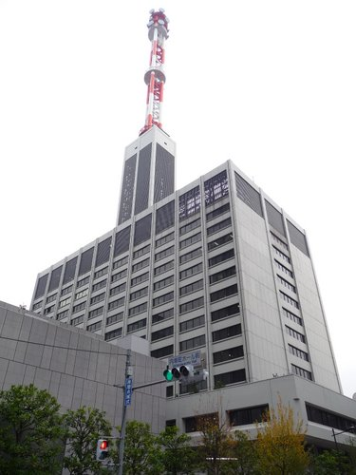
Proposal For National Project
National Project
Independent from TEPCO
Employ worldwide expertise
Integrated Project management
International inspection team
TEPCO
Fukushima
Daiichi
Even TEPCO is owned by the government it is still profit oriented private company, as the same case as GM
Necessity of National Project
13
Notes:
To solve those problems we are proposing those four items:
First is independence from TEPCO head quarters. Even the government invested in TEPCO, it is still private profit oriented company. The investment is just to rescue TEPCO from the bankruptcy as the case of General Motors in USA.
Second is employment of worldwide capabilities, that is, permitting people, firms and resource from nations other than Japan to be employed on this project.
Third is a more centralized and integrated Project Management, subject to oversight by next item.
Fourth is International Inspection Team
I would like to explain item by item now.

Slide 15
Proposal For National Project
Project Team shall be independent from TEPCO
There are so many issues are not known at Fukushima Daiichi, that a profit oriented company never has capabilities to deal with such a project
Presently the project cannot be open and clear due to TEPCO’s own interest
Necessity of National Project
14
Notes:
As I’ve explained, the physical condition of many area of the Fukushima Daiichi complex are as yet unknown, and what we do know indicates the damage is much more complicated in size and scope than what occurred at Three Mile Island. Therefore it is not in the public’s best interest for a project to be handled by a profit oriented private company.
While the project team must be independent from TEPCO, it does not aim to purge TEPCO’s present employees, but rather, it is essential to involve those persons who know the actual site.
The project shall be independent from the “Nuclear Village” as well.

Slide 16
Proposal For National Project
The Project Team shall employ capabilities, knowledge, experiences from all over the world
Fukushima Daiichi is more complex than Chernobyl, and larger in size than TMI-2
The project cannot be handled only by Nuclear Specialists. It’s much complicated Engineering Project
The Project members shall be from TEPCO, Hitachi, Toshiba; and also experienced engineers from Chernobyl, TMI-2, as well as Bechtel, Fluor, TEC, JGC, Chiyoda and/or other companies
Concentrate Capabilities Worldwidely
１８
15
Notes:
It should be noted that while accident at Fukushima Daiichi has discharged a smaller quantity of radio active materials than Chernobyl but much more complicated than it. And comparing with Three Mile Island it is more complicated and larger in scale. This makes Fukushima Daiichi potentially the most difficult disaster to resolve that humanity has ever experienced.
The exact scope of the containment and cleanup project is still unknown. Regardless, there is no doubt about the necessity for world wide collaboration and share of experience. Up to now international collaboration is tried only in the field of Research & Development, but never at work site. In comparison, Three Mile Island accepted several engineers from other countries including Japan. Containment and cleanup at Fukushima Daiichi needs to be an international effort with international oversight.

Slide 17
Proposal For National Project
Integrated Project Management, including progress, quality, cost, and radiation exposure control shall be applied
Project shall be managed in integrated way and avoid multi-layered contract system
Workers shall be employed directly by the Project Team , unless specially required
Allocation of workers including SVCF’s members shall be optimized considering dose in relation to age, skill, work place, etc.
Integration of Operation, Clean-up, and R&D
17
Notes:
Integrated Project Management is essential to coordinate a project of this immense size and scope. Due to historical, cultural, and other factors including multi-layered subcontract system, Japanese firms are accustomed to working independently of each other, without comprehensive project management. I repeat for emphasis that simplified contracting practices are essential for effective integrated project management. Hiring large international firms such as Bechtel, Flour and/or Japanese engineering companies, who have the requisite engineering, construction, and project management skills for a job this size may be the best solution.
After establishing a centralized, integrated project management team, the SVCF’s members can be hired and allocated to suitable jobs and work sites.

Slide 18
Proposal For National Project
Inspection Team consisting of international members shall be formed
Independent Inspection Team shall be free to check safety, progress, etc. to minimize risk of accident and minimize the cost and time
Integrated Project Management
20
17
Notes:
Even the Project Team will be formed to include international members, along with Japanese workers, an international inspection team independent from the Project Team will be essential to ensure maintaining objective view point.
The accident at Fukushima Daiichi isn’t simply local issue. It’s a problem of international scope threatening the wellbeing of the entire world. Therefore, internationality is essential.

Slide 19
Proposal For National Project
SVCF appeals you:
to speak up and to ask your Government to request Japan Government that:
Form a National Project Team for Containment and Cleanup of Fukushima Daiichi, which is independent from TEPCO
Utilize all of the assets in the world
Integrated Project Management shall be the key replacing traditional multi-layered sub-contract structure
International Inspection Team be established
International Inspection Team
18
Notes:
Finally I would like to ask you to speak up and ask your Government to ask the Japanese Government to adopt the SVCF’s four point program.
In case your government doesn’t respond immediately, I’d like you to also write letters to your newspaper editors, and otherwise make it clear to the Japanese government that the rest of the world isn’t willing to let the containment and cleanup drag on longer than necessary. I want you to ask the Japanese government to allow your nation and others to assist in bringing this crisis to a rapid conclusion.
Japanese Government and Bureaucracy are quite conservative, but, fortunately for you and us, very sensitive to the pressure from the USA. Your voice may carry a much stronger punch than ours. It may well make all the difference between life and death for my people and yours.
Thank you very much for inviting me here and listening my presentation. I’d like to express my sincere acknowledgement to all the fine people who worked so eanestly to prepare this event.

